Slide 1
Project: 2048 Game
<Batch No: 01>
AP22110010668 | Poojan Patel
AP22110010714 | Gopikrishnan Harilal Mini
AP22110010719 | Adarsh Kumar
<Project Incharge:> Dr.B.Prasanthi Asst. Professor Dept. of CSE

Slide 2
TABLE OF CONTENTS.
01
02
03
04
05
06
Abstract
Existing Systems
Limitations
Proposed Work
Input Dataset Used
Project Flow

Slide 3
TABLE OF CONTENTS (cont.)
07
08
09
10
Modules Used
Source Code
Output
Conclusion

Slide 4
ABSTRACT
01

Slide 5
Abstract
The 2048 Game is a popular puzzle game that challenges players to combine numbered tiles to reach the elusive 2048 tile. This project aims to implement the 2048 Game using the C programming language and arrays as the primary data structure. The code consists of various functions for initializing the game board, printing the board, adding random tiles, checking game over conditions, and implementing movements. Through this project, the programmer gains hands-on experience in game development, algorithmic thinking, and data structure usage, while providing an entertaining and engaging experience for players.Elephants may be able to detect a thunderstorm from hundreds of miles away, and will head towards it, looking for water.

Slide 6
EXISTING TECHNOLOGY
02

Slide 7
Exisitng Technology
One existing system for the 2048 game is the website "https://play2048.co/". This online platform offers a digital version of the 2048 game that can be played directly in a web browser. The website provides a user-friendly interface and a visually appealing game board, enhancing the overall gaming experience.
On the website, players can easily navigate and interact with the game using arrow keys or swipe gestures on touch-enabled devices. The real-time updates on the score and highest tile achieved add to the excitement and competitiveness of the gameplay. The system also keeps track of players' best scores, allowing them to challenge themselves and strive for higher achievements.

Slide 8
Exisitng Technology (cont.)
Furthermore, the website offers additional features and customization options, such as changing the theme, enabling/disabling animations, and adjusting game settings. This allows players to personalize their gameplay experience and make it more enjoyable.
The existence of "https://play2048.co/" as an online platform provides convenience and accessibility for players who wish to enjoy the 2048 game without the need for downloading or installing any applications. It serves as a convenient and entertaining way to engage with the game, whether on desktop computers, laptops, or mobile devices.

Slide 9
LIMITATIONS
03

Slide 10
Limitations
While "https://play2048.co/" offers an enjoyable experience for playing the 2048 game, it does have some limitations:
1. Limited Platform Support: The website is primarily designed for web browsers, which limits its accessibility on certain platforms. It may not offer dedicated applications for mobile devices or other operating systems, which could restrict gameplay options for users who prefer a more optimized and tailored experience on their specific devices.
2. Lack of Advanced Features: The existing system may lack certain advanced features that are available in other versions or variations of the 2048 game. This could include additional game modes, power-ups, or multiplayer options. The simplicity of the game on the website might be appealing for some players, but it may not cater to those seeking a more complex or challenging gameplay experience.

Slide 11
Limitations (cont.)
3. Limited Customization: While the website provides basic customization options such as changing the theme or enabling animations, it may not offer extensive customization features that allow users to modify the game mechanics, grid size, or tile values. This limitation could impact players who prefer more control over the game's settings to tailor it to their preferences.
4. Lack of Social Features: The existing system may not provide robust social features or integration with social media platforms. Players might miss out on the ability to compete with friends, share their achievements, or engage in community discussions related to the game. These social elements often enhance the overall gaming experience and foster a sense of community among players.

Slide 12
Limitations (cont.)
5. Potential Advertisements and Distractions: As a free online platform, "https://play2048.co/" may rely on advertisements to generate revenue. This could result in interruptions and distractions during gameplay, affecting the immersive experience. Players might encounter pop-up ads, banners, or sponsored content that can detract from the overall enjoyment of the game.
6. Lack of Offline Play: Since the game is played directly on the website, it requires a stable internet connection to access and play. This means that users may not have the option to play the game offline in situations where internet access is limited or unavailable. Offline play is often desirable for users who want to enjoy the game during travel or in areas with unreliable internet connectivity.

Slide 13
PROPOSED WORK
04

Slide 14
Proposed Work
The 2048 Game project is a digital implementation of the popular puzzle game known as 2048. The objective of the game is to slide numbered tiles on a grid, combining them to reach the coveted tile with a value of 2048. The project utilizes the C programming language and employs a simple yet intuitive command-line interface for user interaction.
The game incorporates various essential functions such as initializing the game board, printing the board state, adding random tiles, and implementing the game logic for moves in all four directions. The code structure follows a modular approach, dividing the functionalities into separate functions for improved readability and maintainability. By employing arrays as the primary data structure, the project efficiently manages the game board and implements key operations like merging tiles, shifting them, and checking game over conditions. Overall, the 2048 Game project provides a solid foundation for an engaging and challenging gaming experience.

Slide 15
INPUT DATASET USED
05

Slide 16
Input Dataset used
In the context of the 2048 Game project, the input dataset primarily consists of user input for making moves in the game. The input is obtained through the command-line interface, where the player selects a move by entering a specific character corresponding to the desired direction: 'w' for up, 's' for down, 'a' for left, and 'd' for right.
The input dataset is dynamic and continuously updated as the player progresses through the game. Each move made by the player triggers a new input entry, which influences the state of the game board and determines subsequent moves and outcomes.
It's important to note that the input dataset in this project is not pre-defined or fixed. Instead, it relies on the user's real-time interaction during gameplay to drive the progression and decision-making within the game.

Slide 17
PROJECT FLOW
06

Slide 18
Project Flow
START
Initialize the game board and set all elements to 0 using the initializeBoard() function.
Add two random tiles to the game board using the addRandomTile() function.
Print the current state of the game board using the printBoard() function
Enter move: Read the player's move (w: up, s: down, a: left, d: right) from the user.

Slide 19
Project Flow (cont.)
Perform the corresponding movement based on the player's input:
If the move is 'a', call the moveLeft() function to move the tiles to the left.
If the move is 'd', call the moveRight() function to move the tiles to the right.
If the move is 'w', call the moveUp() function to move the tiles up.
If the move is 's', call the moveDown() function to move the tiles down.
If the move is invalid, print an error message.
Add a new random tile to the game board using the addRandomTile() function.

Slide 20
Print the updated state of the game board using the printBoard() function.
Check if the game is over using the isGameOver() function:
If no tiles are left & if any tile is 2048:
Then the game is over print "Game Over!" and exit the loop.
Else:
If game is not over then again go back to take user’s next move and repeat it until game is over.
Project Flow (cont.)
END

Slide 21
MODULES USED
07

Slide 22
Modules Used
In the 2048 Game project, several modules or functions are utilized to handle different aspects of the game. These modules contribute to the overall functionality and structure of the game. Here is a brief description of the main modules used:
1. `initializeBoard()`: This module is responsible for initializing the game board, setting all the tiles to zero at the beginning of the game.
2. `printBoard()`: This module displays the current state of the game board, showing the values of each tile in a formatted manner.
3. `addRandomTile()`: This module adds a new random tile (either 2 or 4) to an empty spot on the board after each valid move made by the player.

Slide 23
Modules Used (cont.)
4. `isGameOver()`: This module checks whether the game is over or not by evaluating specific conditions, such as reaching the 2048 tile, having no empty cells, or no neighboring cells with the same value.
5. `mergeTiles()`: This module is responsible for merging adjacent tiles with the same value into a single tile, according to the game rules.
6. `shiftTilesLeft()`: This module shifts the tiles to the left on a row or column, eliminating any empty spaces between them.
7. `moveLeft()`, `moveRight()`, `moveUp()`, `moveDown()`: These modules combine the merging and shifting operations to handle the movement of tiles in the respective directions: left, right, up, and down.

Slide 24
SOURCE CODE
08

Slide 25
Source Code
//C Program to create a 2048 Game using the Data Structure - Arrays
#include <stdio.h>
#include <stdlib.h>
#include <time.h>
#define SIZE 4
int board[SIZE][SIZE];
//Initialises the Game Board in the form of memory
void initializeBoard() {
int i, j;
for (i = 0; i < SIZE; i++) {
for (j = 0; j < SIZE; j++) {
board[i][j] = 0;

Slide 26
Source Code (cont.)
}
}
}
//Displays the Game Board
void printBoard() {
int i, j;
system("cls");
for (i = 0; i < SIZE; i++) {
for (j = 0; j < SIZE; j++) {
printf("%d\t", board[i][j]);
}
printf("\n");

Slide 27
Source Code (cont.)
}
printf("Enter move (w: up, s: down, a: left, d: right): ");
}
//Add 2 or 4 in any of the empty tiles
void addRandomTile() {
int i, j;
int emptyCells[SIZE * SIZE][2];
int numEmptyCells = 0;
for (i = 0; i < SIZE; i++) {
for (j = 0; j < SIZE; j++) {
if (board[i][j] == 0) {
emptyCells[numEmptyCells][0] = i;
emptyCells[numEmptyCells][1] = j;

Slide 28
Source Code (cont.)
int i, j;
// Check for 2048 tile
for (i = 0; i < SIZE; i++) {
for (j = 0; j < SIZE; j++) {
if (board[i][j] == 2048) {
return 1;
}
}
}
// Check for empty cell
for (i = 0; i < SIZE; i++) {
for (j = 0; j < SIZE; j++) {
if (board[i][j] == 0) {
return 0;

Slide 29
Source Code (cont.)
}
}
}
// Check for neighboring cells with the same value
for (i = 0; i < SIZE - 1; i++) {
for (j = 0; j < SIZE - 1; j++) {
if (board[i][j] == board[i][j + 1] || board[i][j] == board[i + 1][j]) {
return 0;
}
}
}
return 1;
}

Slide 30
Source Code (cont.)
//Function to merge tiles into one
void mergeTiles(int row[], int size) {
int i, j;
for (i = 0; i < size - 1; i++) {
//Adjacent tiles are same
if (row[i] == row[i + 1]) {
row[i] *= 2;
row[i + 1] = 0;
}
}
}
//Function to shift the tiles left
void shiftTilesLeft(int row[], int size) {
int i, j;

Slide 31
Source Code (cont.)
for (i = 0; i < size; i++) {
if (row[i] == 0) {
for (j = i; j < size - 1; j++) {
row[j] = row[j + 1];
}
row[size - 1] = 0;
}
}
}
//Function to instruct to move left
void moveLeft() {
int i;
for (i = 0; i < SIZE; i++) {
mergeTiles(board[i], SIZE);
shiftTilesLeft(board[i], SIZE);

Slide 32
Source Code (cont.)
}
}
//Function to reverse
void reverse(int row[], int size) {
int i, j, temp;
for (i = 0, j = size - 1; i < j; i++, j--) {
temp = row[i];
row[i] = row[j];
row[j] = temp;
}
}
//Function to transpose the board
void transposeBoard() {
int i, j, temp;

Slide 33
Source Code (cont.)
for (i = 0; i < SIZE; i++) {
for (j = i + 1; j < SIZE; j++) {
temp = board[i][j];
board[i][j] = board[j][i];
board[j][i] = temp;
}
}
}
//Function to instruct to move right
void moveRight() {
int i;
for (i = 0; i < SIZE; i++) {
reverse(board[i], SIZE);
mergeTiles(board[i], SIZE);
shiftTilesLeft(board[i], SIZE);

Slide 34
Source Code (cont.)
reverse(board[i], SIZE);
}
}
//Function to instruct to move up
void moveUp() {
transposeBoard();
moveLeft();
transposeBoard();
}
//Function to instruct to move down
void moveDown() {
transposeBoard();
moveRight();
transposeBoard();

Slide 35
Source Code (cont.)
}
//Main function
int main() {
srand(time(NULL));
initializeBoard();
addRandomTile();
addRandomTile();
printBoard();
char move;
while (1) {
scanf(" %c", &move);
if (move == 'a') {
moveLeft();

Slide 36
Source Code (cont.)
} else if (move == 'd') {
moveRight();
} else if (move == 'w') {
moveUp();
} else if (move == 's') {
moveDown();
} else {
printf("Invalid move!\n");
continue;
}
//system("cls");
printf("\n");
addRandomTile();

Slide 37
Source Code (cont.)
printBoard();
if (isGameOver()) {
printf("Game Over!\n");
break;
}
}
return 0;
}

Slide 38
OUTPUT
09

Slide 39
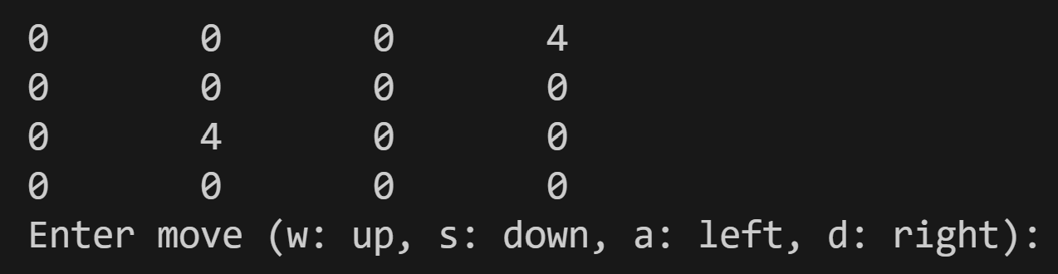
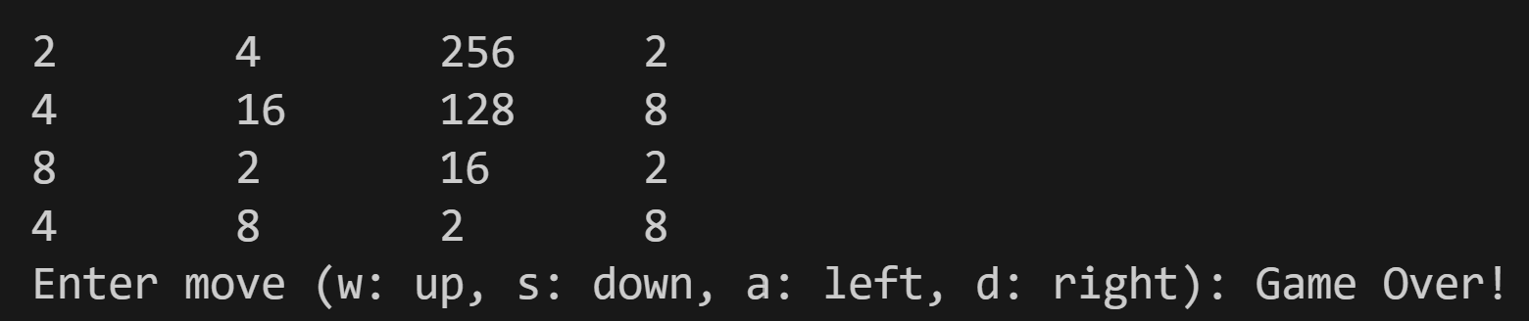
Output

Slide 40
CONCLUSION
10

Slide 41
Conclusion
In conclusion, the 2048 Game project has been a significant endeavor in implementing the popular puzzle game in the C programming language. The project demonstrates the effective use of arrays as a data structure to represent the game board and facilitate various operations such as initializing the board, merging tiles, shifting tiles, and checking game over conditions.
Throughout the development process, the project has showcased the importance of modular programming by dividing the code into separate functions, each responsible for a specific task. This approach enhances code readability, maintainability, and reusability.
The project has successfully replicated the core gameplay mechanics of the original 2048 Game, allowing players to make moves in different directions, merge tiles, and add random tiles to the board. The inclusion of the game loop ensures an interactive and engaging experience for players.

Slide 42
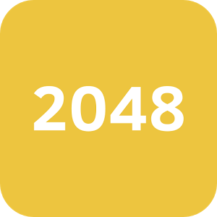
THANK YOU!

